Slide 1
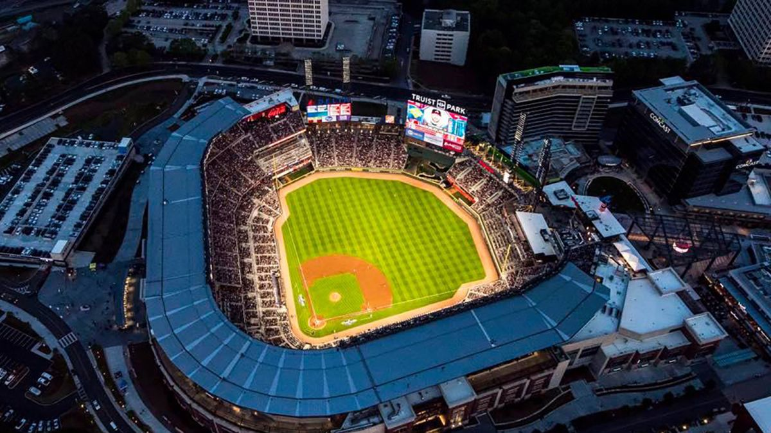

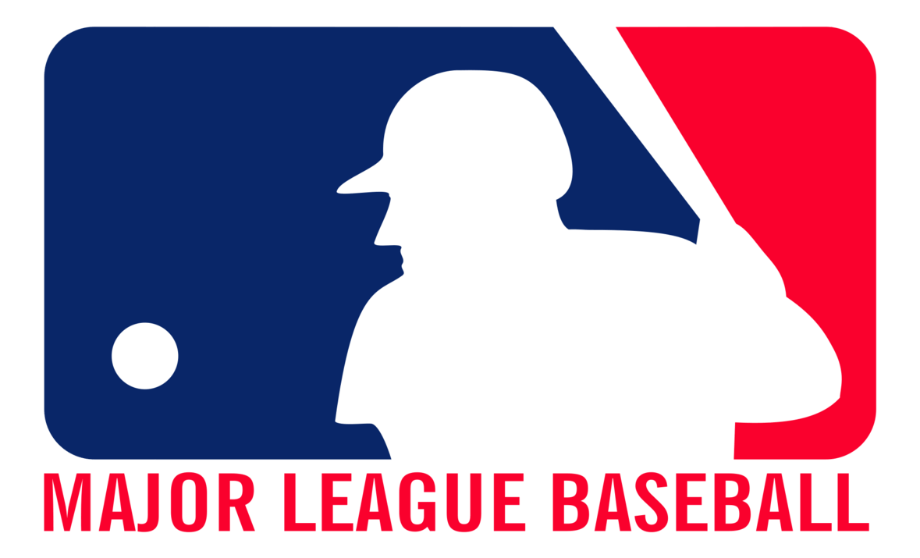

Analysis of Strike calls in the MLB
Jake Arendsen, Adil A Kumar, Halle Steinberg

Slide 2



Project background & motivation
What features of the game of baseball impact the likelihood of a pitch resulting in a strike?
A pitcher’s talent could be indicative of his likelihood of throwing a strike
A higher ERA implies more success in getting batters out – does it also imply a higher likelihood of throwing strikes?
Lots of other factors go into the outcome of an at-bat
What other factors impact the likelihood of a pitch resulting in a strike (swing and miss, foul ball, strike looking)?
How can managers and team administration use this knowledge to form the most optimal lineup?
How can this insight be used dynamically, as lineups and pitching match-ups change from day-to-day?

Slide 3
Our data
Our data comes from Statcast, where we pulled all pitch data for Braves games in 2019, for a total of 24,950 pitches
Data contains 90 variables that describe game environment at time of pitch
Offensive and defensive stats of batter and pitcher, such as release speed, launch angle, spin rate, earned runs, and innings pitched
Setting attributes such as pitch type, inning, score, number of outs, and pitch count
Player characteristics such as right-handed or left-handed

Slide 4
Data preparation & Feature Engineering
Each row in represents a single pitch, each having an end result
To create our target variable, we classified the following results as “Strike” and everything else as “Not Strike”:
Foul
Called Strike
Swinging Strike
Foul Bunt/Missed Bunt
To consider the variation in pitch release points of different pitchers (lefty vs. righty), we used the pitcher’s own deviation from his mean to quantify release location
We created an approximate ERA variable using a pitcher’s Earned Runs and Innings Pitched in 2018
We also created a dummy variable for "intense" situations, which we defined as runners in scoring position and 2 runs or less separating the teams
Features created for analysis…
On 1B – dummy variable to determine if there is a runner on 1B at time of pitch
On 2B – dummy variable to determine if there is a runner on 2B at time of pitch
On 3B – dummy variable to determine if there is a runner on 3B at time of pitch
Pitcher Is Home – dummy variable to indicate whether the pitcher is home or away
Pitcher Is Winning – dummy variable to indicate whether the pitcher’s team is winning at time of pitch
Tied – dummy variable to indicate neither team is winning, or they are tied
Release Position – two variables indicating coordinates of pitcher’s release location
ERA – approximate calculation of pitcher’s Earned Run Average in 2018
Intense – dummy to indicate situation with RISP and ≤2 runs separating the teams

Slide 5
Modeling approaches
Variables selected from original data…
Pitch Type
Pitch Release Speed
Balls – balls on batter at time of pitch
Strikes – strikes on batter at time of pitch
Outs – number of outs at time of pitch
Inning
Pitcher Righty or Lefty
Batter Righty or Lefty
Size of Strike Zone – proxy for batter’s height
Pitch Release Spin Rate – rotations per minute of pitch upon release
Release Extension – how far from the pitching mound a ball is released
At-Bat Number – count of at-bats so far in the game (for team)
Pitch Number – count of pitches thrown by pitcher so far in the at-bat
Runs Scored by Batting Team
Runs Scored by Fielding Team
OPS –sum of on-base percentage and slugging
We filtered our data to keep only 26 variables based on our understanding of factors that could potentially influence a pitch being a strike
In addition to newly created variables, we shortlisted features directly from the original data
We tried multiple classification approaches like Logistic Regression, K Nearest Neighbors, Decision Trees, and Random Forest

Slide 6
Modeling Results
Since our goal is explanatory in nature, we chose to use a Logistic Regression model to explain the relationship between these factors and the outcome of a pitch.
First model included all 26 variables, resulting in 11 significant variables
Second model included only those 11 significant variables
Model explained the same relationships between variables, with the same performance, so we choose to use our first model to best explain the data
More Frequently Strikes
Highest Significance
Larger strike zone
Higher spin rate
Still Significant
More pitches into at-bat
Hitting team’s score
“Intense situation”
ERA
Less Frequently Strikes
Highest Significance
Cutters/Two-Seamers/Sinkers
OPS
Strikes in the count
Still Significant
Most other non-fastball pitches
Runner on 2nd
Pitching Team is winning

Slide 7
How could we improve our model?
More Player Data
Umpire Data
Player data we did use was very significant
Potential to add more variables, such as pitcher ERA+ and batter OPS+
Umpires have different zones
Also have different tendencies to call certain pitches strikes vs. balls
Catcher Data
Data Expansion
Catcher ability is also becoming more and more recognized, though it's not being readily collected/maintained
Framing data, passed balls, and catcher reputation could help
Incorporate more data, possibly more seasons, more teams
Add in “environmental” variables, such as weather, time of day, location, etc.
Find more trends that the Braves don’t frequently encounter

Slide 8
how could our model be used in the world of baseball?
Pitching coaches could attempt to utilize a model to understand what might be causing a pitcher to not throw strikes, when throwing a ball could be ideal, or when throwing a strike could catch a batter by surprise
In scouting particualrly underdeveloped pitchers, a similar model could be used to project whether they could obtain better command in the future
As gambling becomes more and more real time, this could be used to profit by predicting pitch results
Strategy could be built from both knowing what's expected and subverting what is expected
Banging a trash can?

Slide 9


conclusion
We have seen that many aspects of baseball that impact whether or not a pitch will result in a strike.
From a pitcher’s perspective…
From a batter’s perspective…
Use low-ERA pitchers in scenarios where you need a strike – he is more likely to throw a strike
If your team is winning, you are more likely to throw a strike and get the batter to put in play – let the defense help
If you need a strike, throw a fastball – more likely to be a strike than non-fastball pitches
The more strikes on the batter, the less likely you are to throw it in the zone – try to get the batter to swing at junk out of the zone instead
Middle-of-lineup high-OPS batters are less likely to see strikes
If your team has a runner on 2B, you are less likely to see a strike – pitcher may be trying to put a runner on 1B to force the double play
The taller the you are, the bigger your strike zone – look for lots of strikes
Look for a strike in long at-bats – the pitcher will throw strikes to try to get you out

Slide 10
Appendix

Slide 11
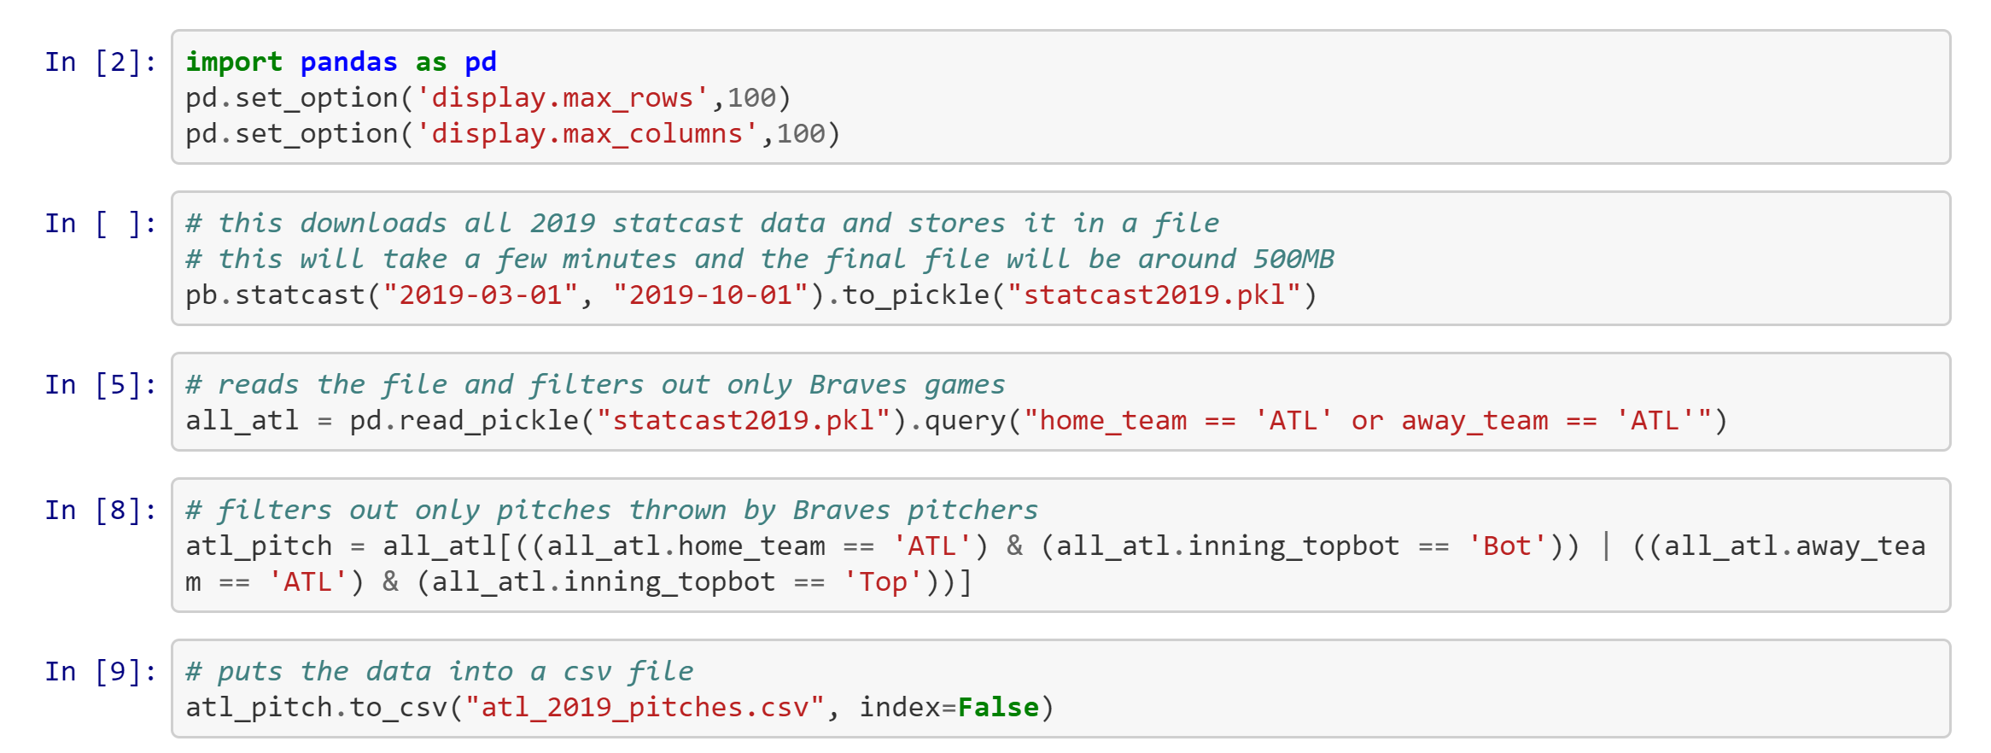
Getting the data
Pulled data only for Braves games in the 2019 season (between March 2019 and October 2019)
Combined with 2018 pitching statistics to get a proxy for season ERA for each pitcher the Braves faced
Data Source: www.statcast.com

Slide 12
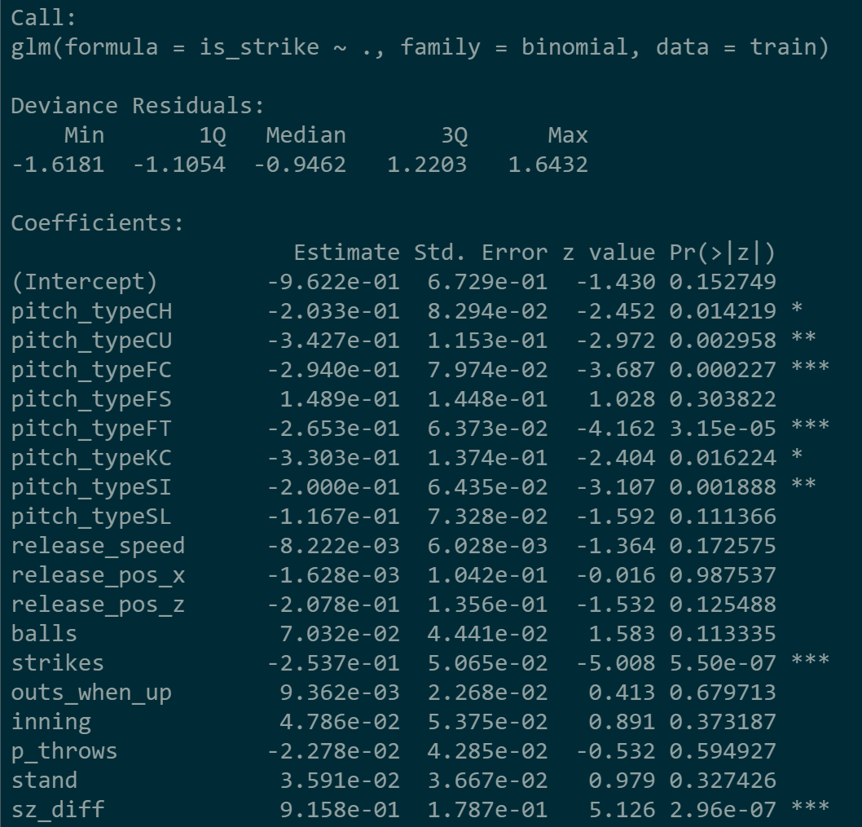
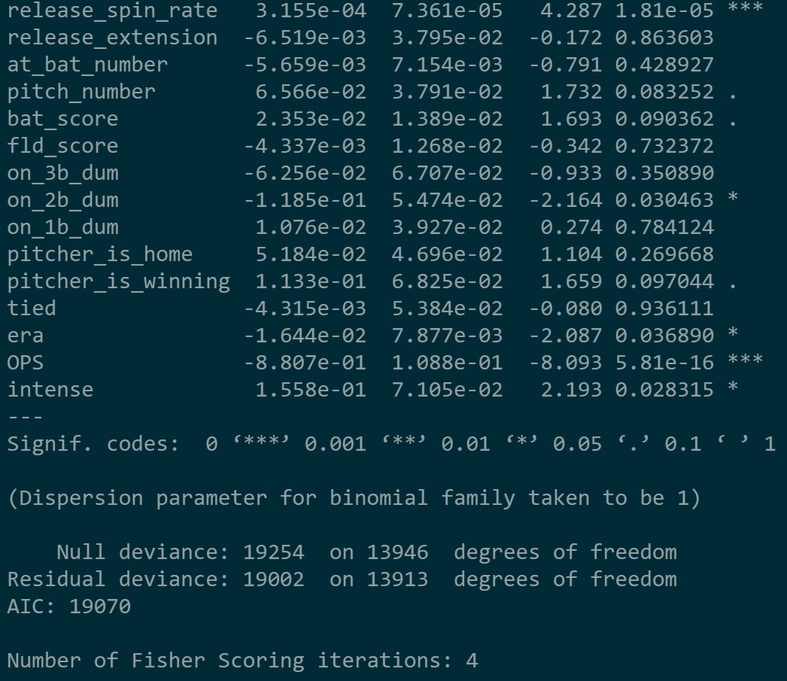
Final model output

Slide 13
Performance Evaluation – FINAL MODEL
Because our model is explanatory in nature, and we are simply looking to explain relationships between variables, we are not as concerned with evaluating performance. Metrics are reported below as a reference.
Actual
Accuracy = 55%
Precision, Strike = 53%
Precision, Not Strike = 56%
Recall, Strike = 32%
Recall, Not Strike = 76%
F-Measure, Strike = 40%
F-Measure, Not Strike = 65%
 | Strike | Not Strike
Strike | 881 | 772
Not Strike | 1,896 | 2,421
Predicted

Slide 14
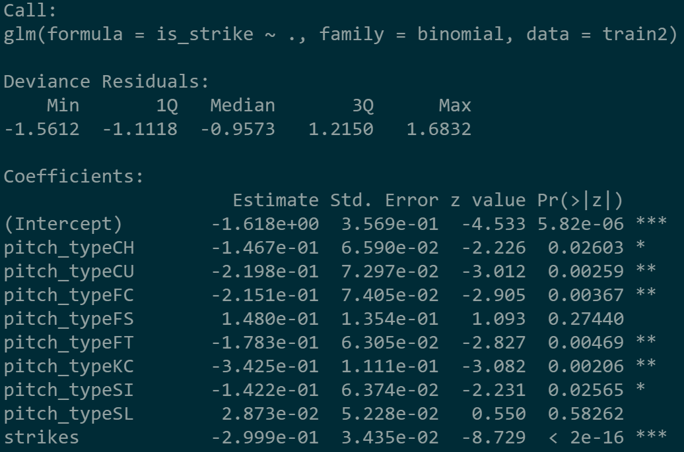
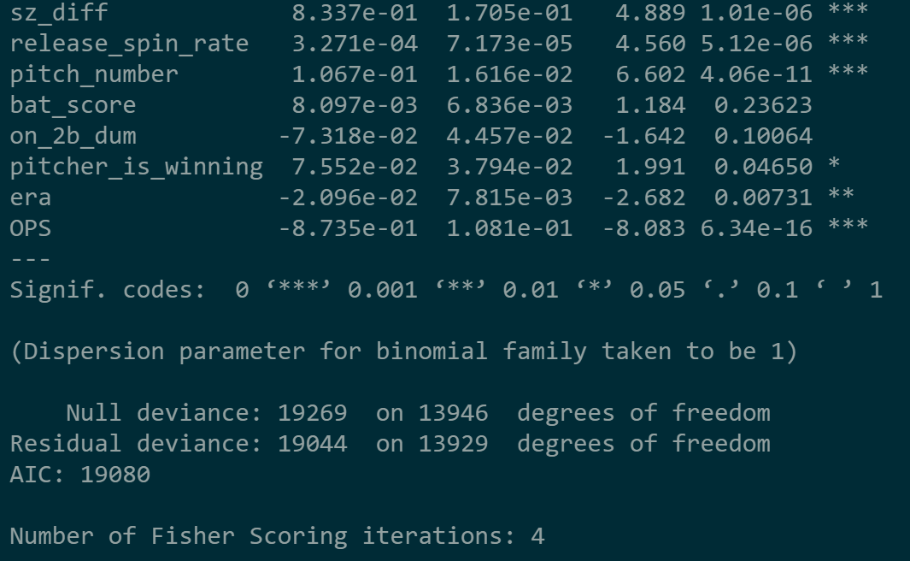
Significant variables model output

Slide 15
Performance Evaluation – significant variables model
Because our model is explanatory in nature, and we are simply looking to explain relationships between variables, we are not as concerned with evaluating performance. Metrics are reported below as a reference.
Actual
Accuracy = 56%
Precision, Strike = 53%
Precision, Not Strike = 57%
Recall, Strike = 32%
Recall, Not Strike = 75%
F-Measure, Strike = 40%
F-Measure, Not Strike = 65%
 | Strike | Not Strike
Strike | 884 | 800
Not Strike | 1,839 | 2,447
Predicted

